Slide 1





“PipeChime: Blockchain based data pipeline to ensure fairness in datasets crowd sourcing.”
Under guidance of
Prof Madhu Nagraj
Assistant Professor,
Department of CSE-DS
ATME College of Engineering, Mysuru
Presented By,
VIGNESH TD[4AD22CD0]
BHARATH .N[4AD22CD007]
RANJITHA [4AD22CD040]
ANANYA RAJ MN [4AD22CD005]
ATME College of Engineering, Mysuru
Department of CSE-DS, ATMECE

Slide 2
CONTENTS
Introduction
Problem Objectives
Literature Survey
Problem statement
Methodology
Conclusion
References
ATME College of Engineering, Mysuru
Department of CSE-DS, ATMECE

Slide 3
INTRODUCTION
Artificial intelligence has been becoming a part of the daily life of human beings since the AI trend in 2020.
PipeChime is a system that helps people collect and share data fairly using blockchain technology.
PipeChime is a blockchain-based data pipeline designed to make crowdsourced datasets fair, transparent, and trustworthy.
In today's AI-driven world, data is power but sourcing that data ethically, transparently, and fairly remains a massive challenge.
ATME College of Engineering, Mysuru
Department of CSE-DS, ATMECE

Slide 4
INTRODUCTION
PipeChime provides a decentralized framework where data contributors can securely upload their data and receive transparent, automated rewards based on quality and value.
By combining the immutability and transparency of blockchain with a decentralized approach to data validation and rewards, PipeChime ensures that crowdsourced datasets are fair and trustworthy.
ATME College of Engineering, Mysuru
Department of CSE-DS, ATMECE

Slide 5
Problem Objectives
Enable Decentralized Data Contribution : It means letting anyone, anywhere share their data without needing to go through a big company or central system.
Ensure Data Traceability and Transparency : means making sure that you always know who added the data, when they added it and no one secreatly change it later.
Design a Fair and Incentive-Based Reward Mechanism : means creating a system where people who share good and useful data get rewards.
Implement On-Chain Verification and Smart Contract Auditing : On-Chain Verification means everything is written on the blockchain, so it’s clear and can’t be changed and Smart Contract Auditing ,it is used to check the rules to make sure they work properly and fairly.
ATME College of Engineering, Mysuru
Department of CSE-DS, ATMECE

Slide 6
Literature Survey
S.No | Title | Authors | Years | Summary
1. | A large-scale hierarchical image database. | Jia Deng, Wei Dong, Richard Socher, Li-Jia Li, Kai Li, and Li Fei-Fei | 2009 | In 2009 IEEE conference on computer vision and pattern recognition, pages 248–255. IEEE,
2. | A Next-Generation Smart Contract and Decentralized Application Platform | Vitalik Buterin, Ethereum | 2014 | A Next-Generation Smart Contract and Decentralized Application Platform
ATME College of Engineering, Mysuru
Department of CSE-DS, ATMECE

Slide 7
Literature Survey
S.No | Title | Authors | Years | Summary
3. | Image super-resolution via deep recursive residual network. | Ying Tai, Jian Yang, and Xiaoming Liu. | 2017 | In Proceedings of the IEEE conference on computer vision and pattern recognition, pages 3147–3155
4. | Incentive Mechanisms for Quality Data Contribution in Blockchain-Based Crowdsourcing | Garcia, G. Rodriguez | 2018 | This study analyzes various incentive models, including token-based rewards and reputation systems
5. | Distributed, decentralized, and democratized artificial intelligence. | Gabriel Axel Montes and Ben Goertzel | 2019 | Technological Forecasting and Social Change, pages 141:354–358
ATME College of Engineering, Mysuru
Department of CSE-DS, ATMECE

Slide 8
Literature Survey
S.No | Title | Authors | Years | Summary
6. | Blockchain for Data Provenance and Integrity in Crowdsourced Datasets | A. Smith, B. Jones, C. Davis | 2020 | It discusses cryptographic linking of data blocks to ensure tamper-proof provenance.
7. | Decentralized Data Marketplaces: Challenges and Opportunities | L. Green, M. Hall | 2020 | This survey provides an overview of the current landscape of decentralized data marketplaces
8. | Secure and Privacy-Preserving Data Aggregation in Blockchain-Based Systems | N. Patel, O. Khan | 2021 | This research explores methods for securely aggregating sensitive data from multiple
ATME College of Engineering, Mysuru
Department of CSE-DS, ATMECE

Slide 9
Literature Survey
S.No | Title | Authors | Years | Summary
9. | Addressing Data Bias in Crowdsourced AI Datasets through Blockchain Auditing | J. White, K. Brown | 2022 | This work focuses on the ethical implications of data bias in AI and proposes a blockchain-enabled auditing layer to track
10. | Ocean protocol | Trent McConaghy | 2022 | Tools for the web3 data economy. In Handbook on Blockchain, pages 505–539. Springer
ATME College of Engineering, Mysuru
Department of CSE-DS, ATMECE

Slide 10
APPLICATION
AI & Machine Learning Dataset Creation : Collects high-quality, diverse training data from multiple sources.
Healthcare Research & Medical Studies : Enables safe and fair collection of sensitive health data for research. Maintains privacy, transparency, and trust between patients and researchers.
Educational Platforms : Rewards contributions using incentive mechanisms powered by smart contracts.
Open Data Platforms & Government Projects : Used by governments to crowdsource data (e.g., census, traffic, surveys). Builds public trust through transparency and fairness.
ATME College of Engineering, Mysuru
Department of CSE-DS, ATMECE

Slide 11
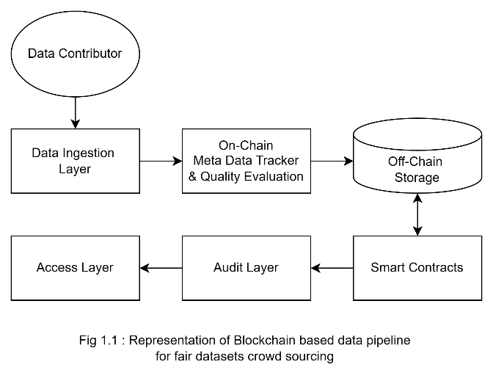
METHODOLOGY
Data Contributor : Term data contributor refers to a person, organization, or system that provides data to a database, platform, research project, or system.
Data Ingestion Layer : This is where contributors interact with the system and users submit datasets like images, text, or structured data through an interface that collects and prepares the data for further processing.
On-Chain Metadata Tracker & Quality Evaluation : A tool that looks at information stored on a blockchain and checks if the information is correct and complete.
ATME College of Engineering, Mysuru
Department of CSE-DS, ATMECE

Slide 12
METHODOLOGY
Off-Chain Storage : storing big files somewhere else, not directly on the blockchain, The actual file (like a photo, video, or document) is kept in another place (like Google Drive, cloud storage) .This keeps the blockchain fast and cheap, but the data is still safe and easy to find.
Smart Contracts : A smart contract is like a computer program that runs by itself on the blockchain. It works like it has rules written in code.
Audit Layer : An audit layer is like a checker that makes sure everything is correct and safe .And helps make sure no one is cheating or doing anything wrong.
Access Layer : The access layer is the part of a system that controls - Who can get in and What they are allowed to see or do , and it makes sure that only the right people can look at or change certain things.
ATME College of Engineering, Mysuru
Department of CSE-DS, ATMECE

Slide 13
CONCLUSION
Pipechime offers a groundbreaking approach to addressing fairness, transparency, and trust in crowdsourced data collection.
As AI and data governance become more critical, PipeChime offers a secure, decentralized, and privacy-respecting foundation for next-gen data systems.
Pipechime can be enables anyone from researchers to citizens to contribute and benefit from data, creating inclusive AI ecosystems.
When AI models are trained on fair, and community-verified data, users and stakeholders are more likely to trust the outcomes.
It Enables Transparent Collaboration:Where researchers and other communities without needing to trust a central authority because transparency is built in
ATME College of Engineering, Mysuru
Department of CSE-DS, ATMECE

Slide 14
REFERENCE
Wikipedia, History of Artificial Intelligence, AI Boom
Forbes E-Article, Harnessing Generative AI: A $4.4 Trillion Opportunity For The Global Economy
IBM E-Article, The future of AI: trends shaping the next 10 years
Ying Tai, Jian Yang, and Xiaoming Liu. Image super-resolution via deep recursive residual network. In Proceedings of the IEEE conference on computer vision and pattern recognition, pages 3147–3155, 2017.
Jia Deng, Wei Dong, Richard Socher, Li-Jia Li, Kai Li, and Li Fei-Fei. ImageNet: A large-scale hierarchical image database. In 2009 IEEE conference on computer vision and pattern recognition, pages 248–255. IEEE, 2009
ATME College of Engineering, Mysuru
Department of CSE-DS, ATMECE

Slide 15
REFERENCE
Gabriel Axel Montes and Ben Goertzel. Distributed, decentralized, and democratized artificial Intelligence. Technological Forecasting and Social Change, 141:354–358, 2019.
Trent McConaghy. Ocean protocol: Tools for the web3 data economy. In Handbook on Blockchain, pages 505–539. Springer, 2022
ATME College of Engineering, Mysuru
Department of CSE-DS, ATMECE

Slide 16
THANK YOU
ATME College of Engineering, Mysuru
Department of CSE-DS, ATMECE

